Slide 1


Text and Image Based Multi-model Fashion Image Retrieval system
Aafaq Iqbal Khan
X20108851
Research Project Presentation.

Slide 2

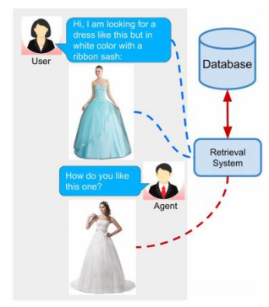
Introduction
Image retrieval in Fashion Domain.
The need of Multi-model Image Retrieval system.
Image Encoder
Efficient-Net
Resnet-50
Text Encoder
LSTM
Multi-model approach
(Text Image Residual Gating) TIRG
Notes:
Image retrieval is an emerging research topic playing a significant role, especially in the fashion domain. Where, with the increasing sizes of fashion product catalogs and the number of attributes per product. People may not be able to describe the specifications of the outfits more accurately by using a text based query in conventional fashion e-stores.
For example, a user has a query image of a dress but the she wants to buy a similar dress with the white color shown in figure. In this scenario, the image retrieval system should be capable to formulate the query by combining the query image with a text string that defines an intended image modification.
Therefore, in this project we investigate the multi-model concept to integrate the query image with a text phrase that describing visual differences between the query image and the target image.
Both candidate and target images are encoded with Efficient-Net and ResNet-50 (only one at a time) into high-level representations, and encode text descriptions to a single text vector using LSTM. Then we compose the candidate image vector and text representation into a single vector which is expected to be biased toward the target image vector with the help of state-of-the-art TIRG.

Slide 3
Research Question
“To what extent, integrating both text query and image query help to improve the fashion image retrieval system by investigating a multi-model approach TIRG (Text Image Residual Gating)?”
The major objectives of studies are:
Compare the performance (recall as major evaluation matrices) of the Only-Test based, Only-Image based, and both text and image multi-model based image retrieval system.
Evaluate Image retrieval system with different image encoder, ResNet-50 and Efficient-Net.

Slide 4

Literature Review
Scopus, Google Scholar, and NCI Library catalogue by using appropriate keywords.
Resnet is the most common CNN model among the researchers in the image-retrieval system.
Efficient-Net also shown great results in image classification tasks.
Based on Literature review, Resnet-50 and Efficient-Net selected as CNN model
Notes:
For the literature review, academic papers were searched in Scopus, Google Scholar, and NCI Library catalog by using keywords related to our research fashion retrieval system, and deep learning methods.
After the critical review of the research papers, we understood that choice of an appropriate method to combine the image features and textual features could be the important factor of the interactive image retrieval system. We observed that CNN models especially ResNet are the most common methods among the researchers in the image-retrieval system. So we select ResNet as one of our CNN models along with Efficient-Net. Because It also shown great results in image classification. but as per our best knowledge efficient-net has not been used for multi-model image retrieval system. Therefore this research paper extends the use of Efficient-Net for image retrieval tasks on our dataset.

Slide 5
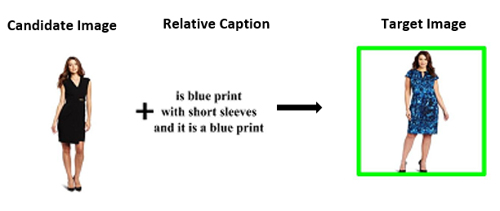
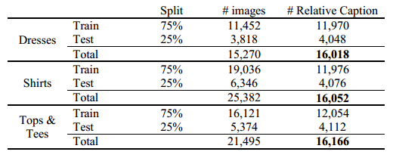
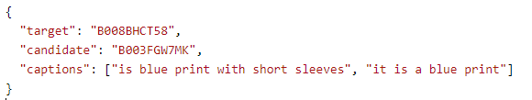
Fashion IQ dataset
77,683 fashion product images.
Categories
Dresses
Tops&Tees
Shirts
30,134 pairs of reference/candidate and target images with text caption
Notes:
The dataset used for analysis is fashion IQ dataset that has a total of 77,683 fashion product images that cover three product categories Dresses, Tops&Tees, and Shirts. Moreover, images are divided into 30,134 pairs of reference/candidate and target images, annotated with relative captions by human annotators, which describe the difference between candidate and target images (e.g., “shorter more fancy”). Each training pair is represented by triplet (reference image, caption, target image).
The test and train data split for each category is shown in table.

Slide 6
Data Pre-processing and Data Transformation
Image Data:
Images need to be converted into “RGB” format by making a triple 8-bit value.
Random horizontal flip
Random cropping
Text Data:
Normalization
Concatenate Caption
Non-alphanumeric and spell checker
Notes:
Initially, images need to be converted into “RGB” format by making a triple 8-bit value. we employ several techniques to do image transformation on both candidate and target images before encoding them into feature vectors. These approaches include the random horizontal flip and random cropping, and normilaization.
For text pre-processing, each caption is further split into two captions that are associated with pair of candidate image and target images. Firstly, concatenate these two captions into single sentence and check for any non-alphanumeric word existence. By further investigation, I found that Fashion IQ dataset includes some misspelled words to correct this a python library is used.

Slide 7
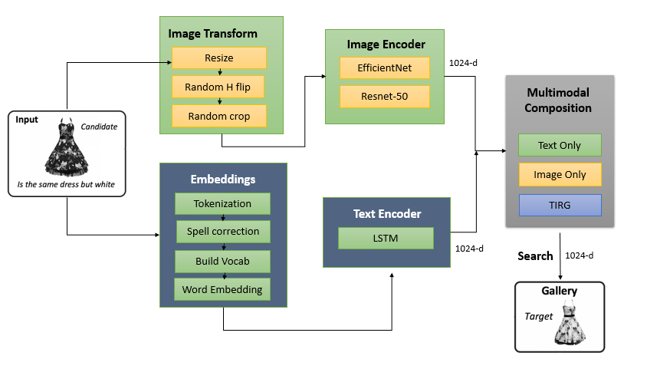
Design Architecture
Notes:
The query image go into image encoder. For image encoding, we used two CNN models EfficientNet and Resnet-50. As Efficient net showed great performance in other image classification task in fashion domain. EfficientNet not only has good accuracy but also model efficiency by lowering the number of parameters used during training in comparison to other CNN. EfficientNet is available in a range of variants. I used EfficientNet-B0 which is trained on imagenet. both candidate and target image feed into image encoder and linearly project outputs into the same space, which has 1024 dimensions. Text Encoder: Convert the concatenated captions into tokens and then into text embeddings and feed them to the LSTM which gives 1024 dimension feature vector. Multi-model Composition layer: Compose candidate vectors and caption representation into the same space as the image vector by using TIRG composition. By doing this, we expect the candidate image vector to be biased toward the target image vector so that similarity between candidate and target image vectors is larger than that between candidate and other images which are not the target image.

Slide 8

Implementation
Google Colabotory is used for implementation.
Limited Computational Resources
Python libraries and packages
Notes:
For implementation, we used Colab, as the local machine is not a feasible solution to train the fashion-IQ dataset that have around 77k images. Moreover, CNN and LSTM models require more time to process the images and text while training the model.
The colab provides 12 GB of RAM in free mode which is not enough to train the model on Fashion-IQ dataset. When we try to train our models on just a single category all of the RAM is utilized and session got crash. To tackle this issue, we optimize and configure our code to make it compatible with colab provided GPUs that is NVidia Cuda.
We are managed to train our model on only two categories dress and shirt data individually.
For implementation, python libraries PyTorch are used. Python version 3 is used on google colaboratory notebook. Data is uploaded on google drive and accessed by mounting google drive. Image transformation and normalisation are done using numpy, PIL and Keras libraries from python.

Slide 9
Evaluation
main evaluation metric for retrieval is recall at rank k (R@K) where K can be 1, 3, 5, 10, 20 and 50.
each model will also be evaluated based on batch based classification training loss and time performance on training dataset
The evaluation section is divided into following two broader parts
Quantitative Results
Qualitative Results
Notes:
Our main evaluation metric for retrieval is recall at rank k (R@K) where K can be 1, 3, 5, 10, 20 and 50. It is calculated as the percentage of test queries where target image is within the top K retrieved images. This will be repeated for dress and shirt categories. Along with it, each model will also be evaluated based on batch based classification training loss and time performance on training dataset.
The evaluation section is divided into following two broader parts
Quantitative Results
Qualitative Results

Slide 10
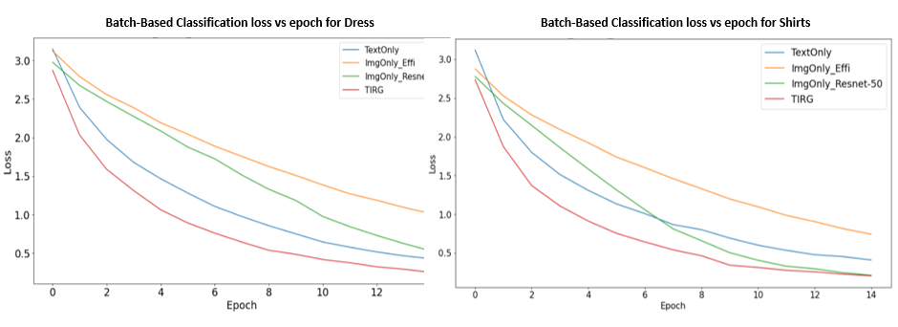
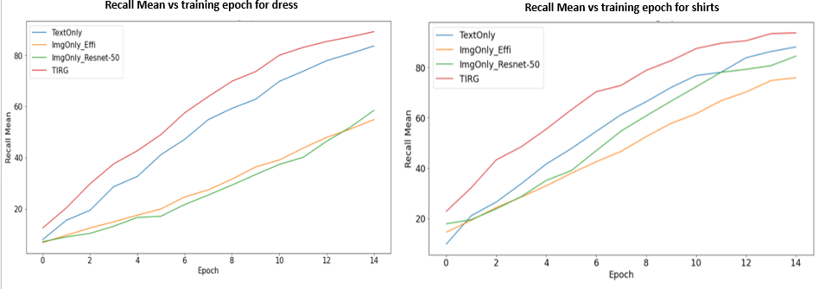
Quantitative Results
Notes:
Epoch vs training loss:
The loss is gradually decrease with increasing epoch. At initial stage all models have almost same loss but at the end, the multi-model TIRG has the lowest loss as compared to other models. And img only resnet 50 has the highes.
The mean of the recall is ploted against epoch. We can see that Text-Only and TIRG performs well and have higher recall mean while both Image only models (Resnet-50 and Efficient-Net) do not show high recall mean when compare to TIRG and Text-only method. The justification of this point is that, as the captions of the images are annotated by the human experts, so dataset has very accurate and real description of the difference between query and target images. The image only based models do not utilize the textual information while retrieving the images

Slide 11
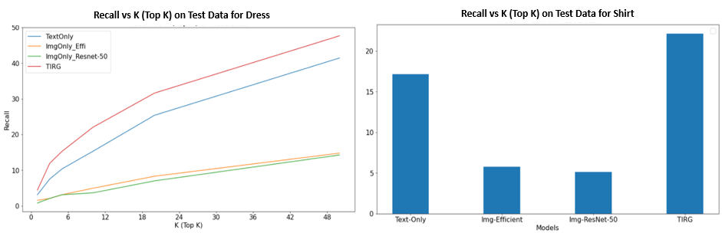
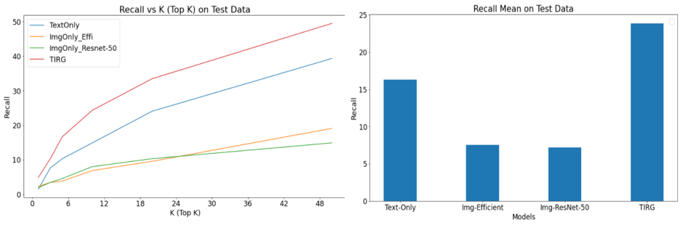
Quantitative Results
Notes:
After evaluating the model on training data, evaluation is also done on test dataset. The evaluation metrics is kept same. The figure represent the results on test data for dress and shirt category respectively. The recall values are plotted against different rank (Top K) for each model. The TIRG model outperforms the other models with having highest recall values for all rank (Top K). Similar to training data, only image based models do not perform well on test data in terms of recall.
For both dress and shirt categories, TIRG has highest recall mean (Approx. 24) on test data followed by Text-only method (Approx. 17).

Slide 12
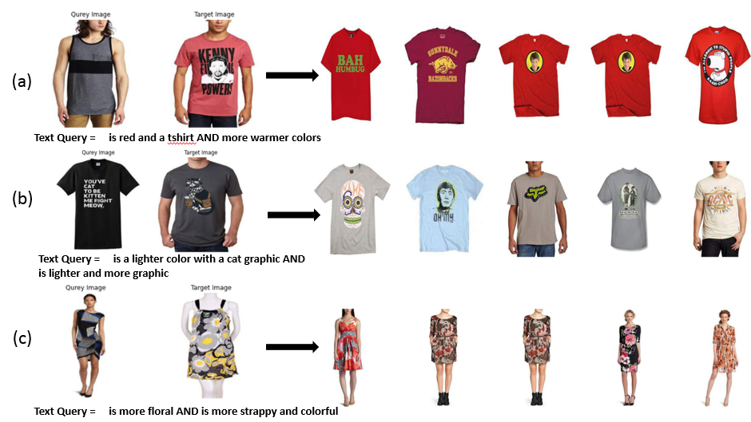
Qualitative Results
Notes:
Some qualitative results are reported in slide that show that top 5 retrieved similar images with the help of the TIRG model. For simplicity, only the TIRG results are shown, other method results are provided in code notebook. The candidate image and text queries along with it ground truth target image are provided at left and the top 5 highest-scored retrieved images are at right side. Our methods assign higher value of dot product similarity to the images that best meets the requirement of the user query while keeping the style of the original query image.

Slide 13
Conclusion and future work
Compare the unimodel and multi-model image retrieval system and shows that how results can be improved by using both text and image query
The TIRG outperforms the other methods Text only, Image-only efficient-net, Image-only Resnet-50.
Future work
Integrate our methods with knowledge base concept.
Extend the applicability of the multi-model image retrieval system to other domains.
Notes:
This paper compare the unimodel and multi-model image retrieval system and shows that how results can be improved by using both text and image query simultaneously.
we can conclude that TIRG outperforms the other methods text only, img only effi, image only resnet in terms of recall and training loss significantly on Fashion-iq dataset.
Possible future directions of this research work can be, integrate our methods with knowledge base concept so our models can have better understanding of dress design styes and correlation between them such as formal shirts have proper collar and embroidered dress are usually wedding dress.
Another future work is to extend the applicability of the multi-model image retrieval system because it can be apply to any image and text pair data. This approach is not limited to fashion domain, in fact, it may apply for other domain such as, food, shoes, and so on

Slide 14
Thank You

